Slide 1
Coordination Chemistry-I
Dr Semanti Basu
Assistant Professor
Department of Chemistry
Bejoy Narayan Mahavidyalaya,
Itachuna, Hooghly, W. B., India

Slide 2
Importance of Coordination Chemistry
• In the natural world, complexes of iron, haemoglobin, myoglobinand , cytochromesare known as oxygen transport, oxygen storage and electron transport molecules respectively.
• Some complexes of iron, zinc, copper and molybdenum are involved in enzymatic processes in biological systems.
• Medicines like cis-platinand carboplatin-anticancer drugs.
• Some 3-d metal Schiff base complexes are known for their antitumor activity.
• Many industrial catalysts are metal complexes like Wilkinson catalyst
• In analytical chemistry, separation of metal ions, Ag⁺, Hg₂²⁺, Cu²⁺, Cd²⁺, Ni²⁺,Co²⁺ etc. is achieved by complex formation reactions.
• Quantitative estimation of Ca²⁺ and Mg²⁺ ions is performed titrimetrically using ethylenediamine tetra acetic acid.
• The concentration of metal ions, Cu²⁺, Co²⁺, Zn²⁺ and Ni²⁺ etc. is determined gravimetrically as their stable complexes.

Slide 3
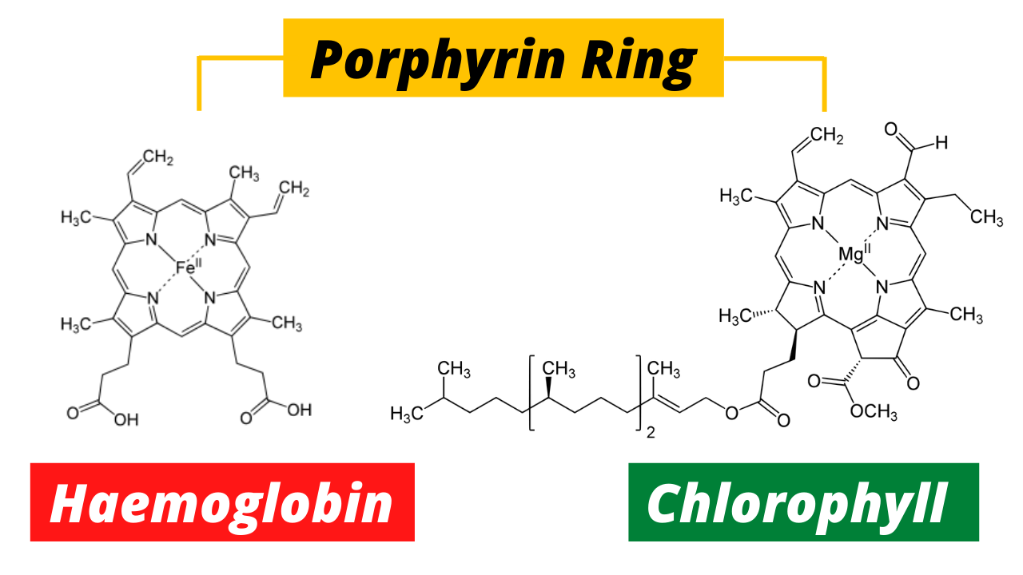
Natural Coordination Complexes

Slide 4
Double salts and complex salts or compounds
Double salts | complex salts
1. These exist only in solid state and dissociate constituent species in their solution. | 1. They retain their identity in solid as well as in solution state.
2. Ex. Mohr's salt: FeSO₄. (NH₄)2SO₄.6H₂O | 2. Ex. [Co(NH₃)₄Cl₂]Cl .
3. Hydrolysis: FeSO4. (NH₄)2SO₄.6H₂O → Fe⁺², NH4⁺, SO₄⁻² | 3. Hydrolysis: [Co(NH₃)₄Cl₂]Cl → [Co(NH₃)₄Cl₂]⁺ + Cl⁻
4. They lose their identity in dissolved state. Their properties are essentially the same as those of constituent species. | 4. They do not lose their identity in dissolved state. Their properties are different from those of their constituents. For example [Co(NH₃)₄Cl₂]⁺ does not show the test of Co⁺³ , , NH4⁺ and Cl⁻ ions.
5. In double salts the metal atom/ion exhibit normal valency. | 5. In co-ordination compounds, the number negative ions or molecules surrounding the central metal atom is beyond its normal valency.

Slide 5
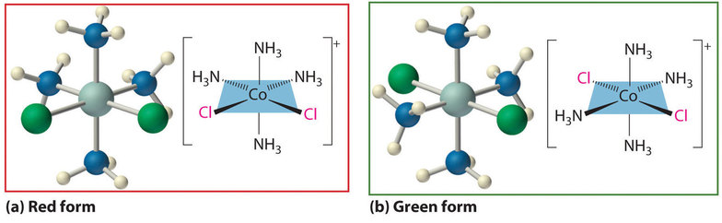
Coordination Compounds
A compound containing coordinate bonds, typically between a central metal atom and a number of oppositely charged ions or neutral atoms more than its normal valency

Slide 6
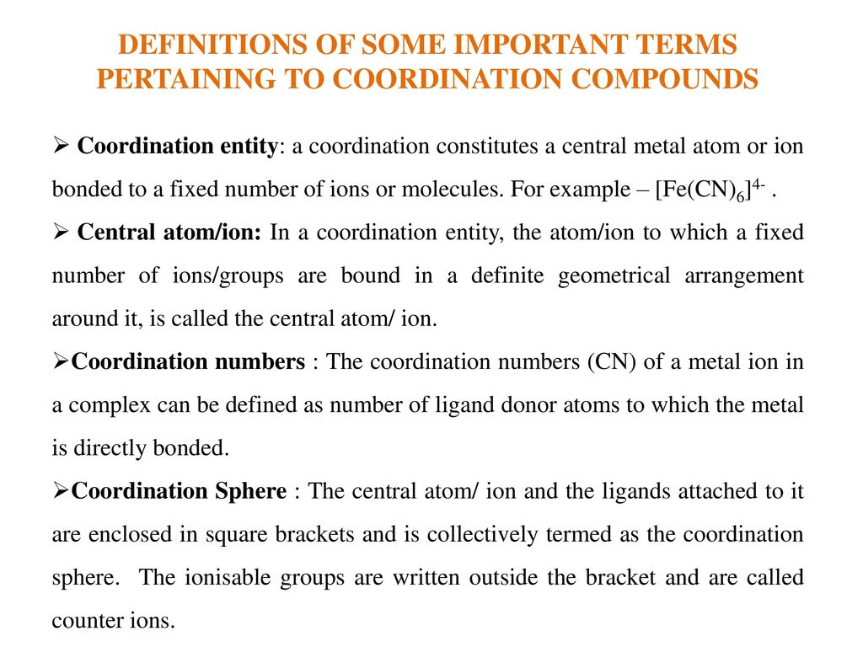

Slide 7
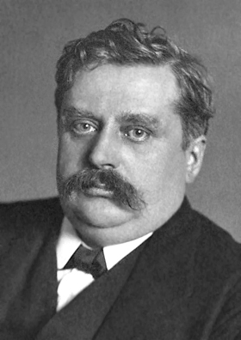
Werner’s Theory of Coordination Complex
Father of Coordination Chemistry
It was the 1st example of Nobel Prize in Inorganic Chemistry
Alfred Werner
Swiss Chemist
Nobel prize on 1913

Slide 8
Werner’s Theory of Coordination Complex
Postulate (1893)
In coordination compounds central metal ion possess two types of valency (means linkage), primary valency and secondary valency.
2. The primary valances are ionizable and are satisfied by negative ions and is equal to oxidation number of the metal (Ionization sphere).
3. Secondary valances are non-ionizable. These are satisfied by neutral molecules or negative ions. Secondary valency is equal to coordination number and is fixed for a metal (Coordination sphere).

Slide 9
Werner’s Theory of Coordination Complex
Postulate (1893)
4. Secondary valances are directional and so a complex has a particular shape The number and arrangement of ligands in space determines the stereochemistry of a complex
Primary valency = Oxidation number
Secondary valency = Coordination number

Slide 10
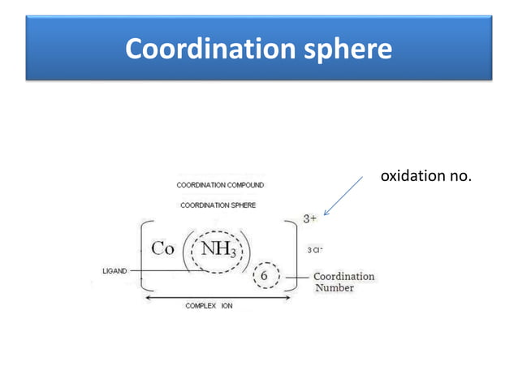

Slide 11
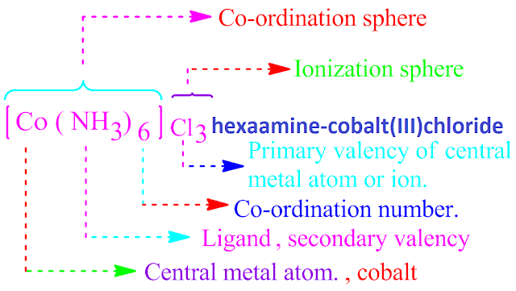
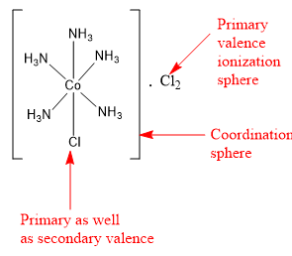
Werner’s Theory

Slide 12
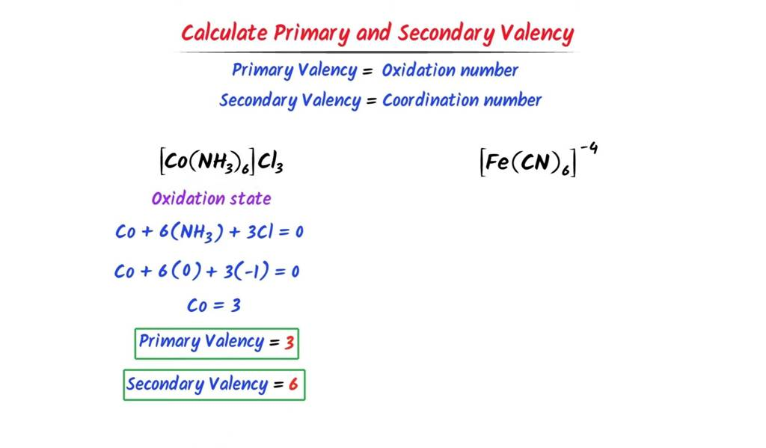
Werner’s Theory

Slide 13
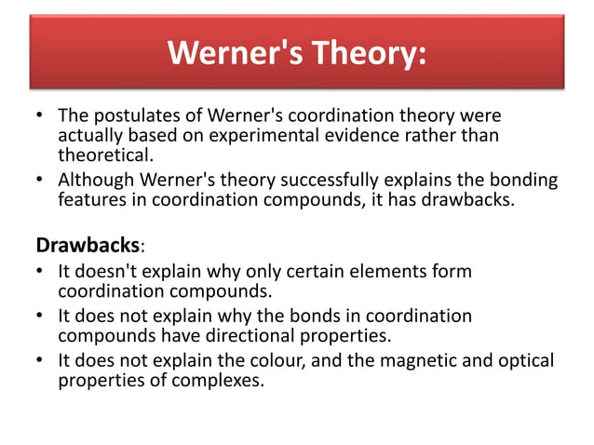

Slide 14
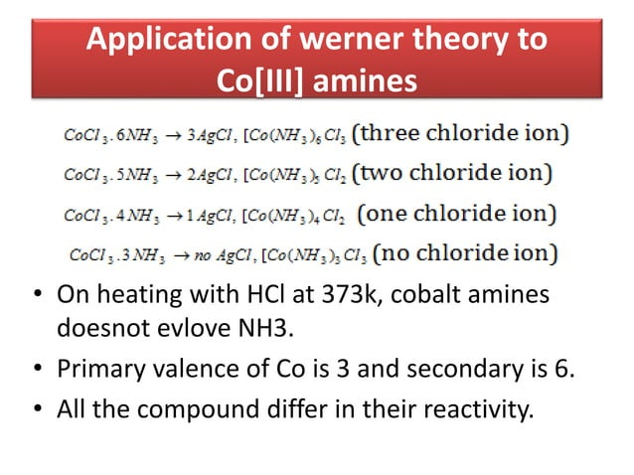

Slide 15
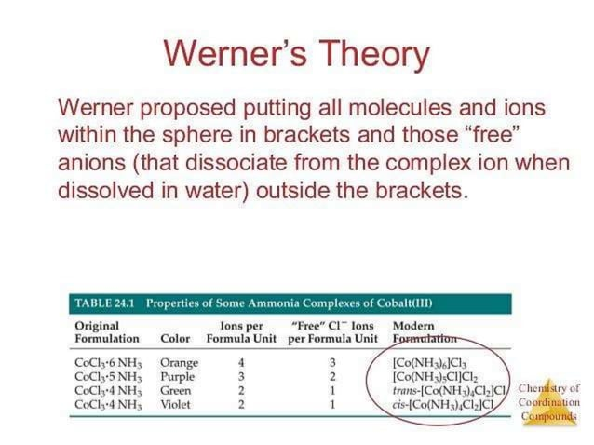

Slide 16
Coordination Complex
• A coordination complex consists of a central atom or ion which is usually metallic and is called coordination center and a surrounding array of bound molecules or ions that are in turn, known as ligands or complexing agents.
• Ligands are Lewis bases containing at least one pair of electrons to donate to a metal atom or ion.
Nature of complex
Depending on the charge, a complex may be cationic, anionic or neutral.
[Fe(H₂O)₆]²⁺ : Cationic complex
[Fe(CN)₆]⁴⁻: Anionic complex
[Ni(CO)₂]: Neutral complex
•Metal Is usually a transition metal. Transition metals are-
(i)Small, highly charged ions with variable oxidation states
(ii) Possess vacant / filled orbitals of right energy to accept electrons.

Slide 17
Coordination Number
• Number of atoms, ions or molecules that a central atom or ion holds as its nearest neighbors in a complex or coordination compound or in a crystal is known as coordination number.
• Ligands: The molecule or ion which are coordinated to a central metal atom or ion. They are classified in various ways-On the basis of charge, ligand may be neutral, anionic and cationic.
(a)Anionic-halide ions, CN⁻
(b)Cationic-NO⁺, [N₂H₅]⁺
(c)Neutral: NH₃, H₂O
•On the basis of ligand field strength
(a)Weak field ligands: I⁻, Br⁻, Cl⁻, F⁻, H₂O
(b)Strong field ligands: CN⁻, CO, o-dipyridyl, 1,10 phenanthroline, ethylenediamine, ammonia, pyridine

Slide 18
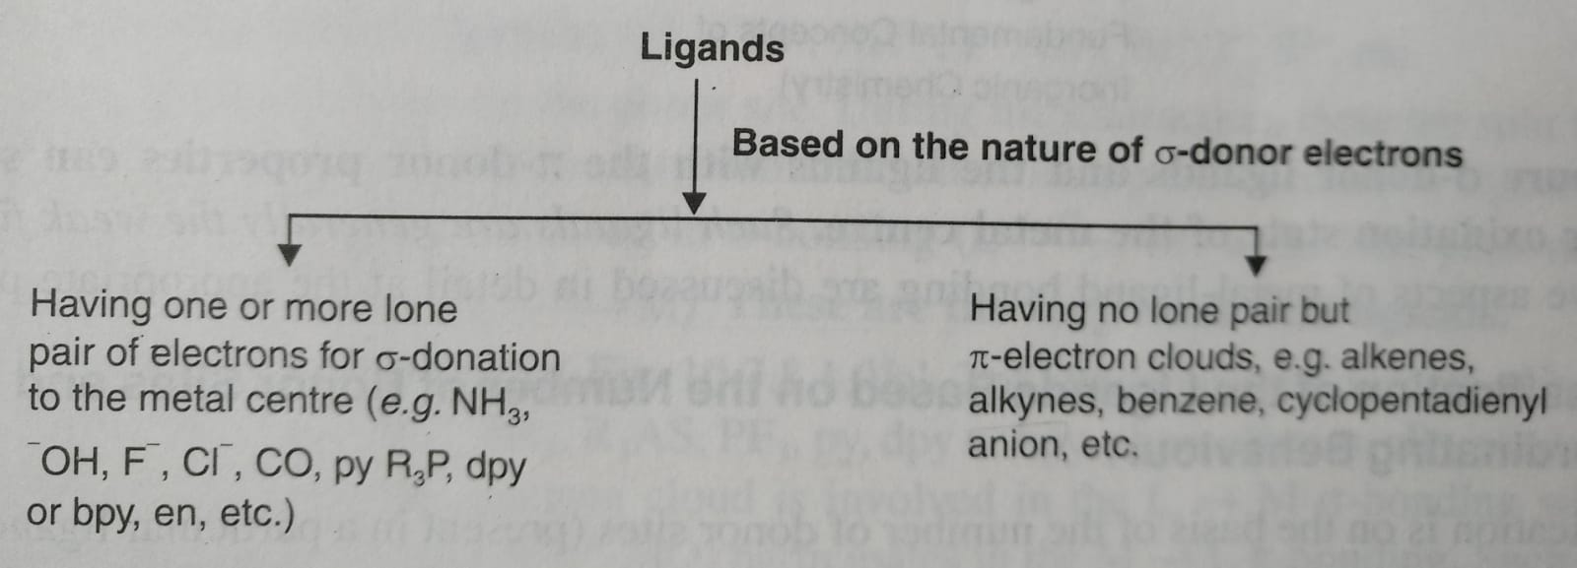
Ligand
On the basis of nature of bonding i.e. donor & acceptor properties of ligand

Slide 19
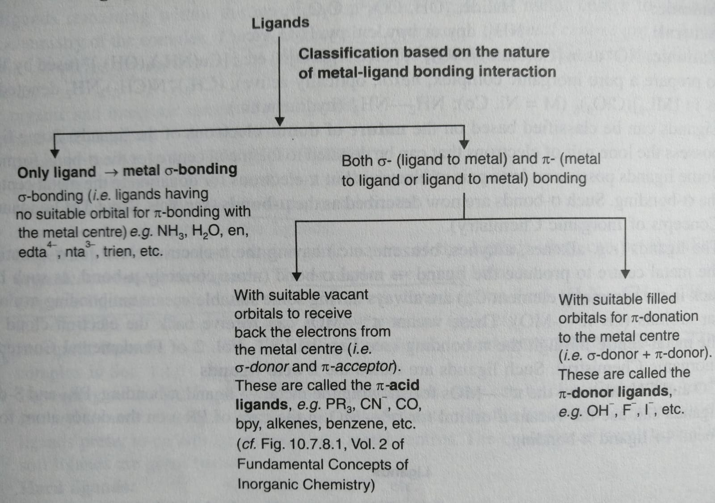
Ligand

Slide 20
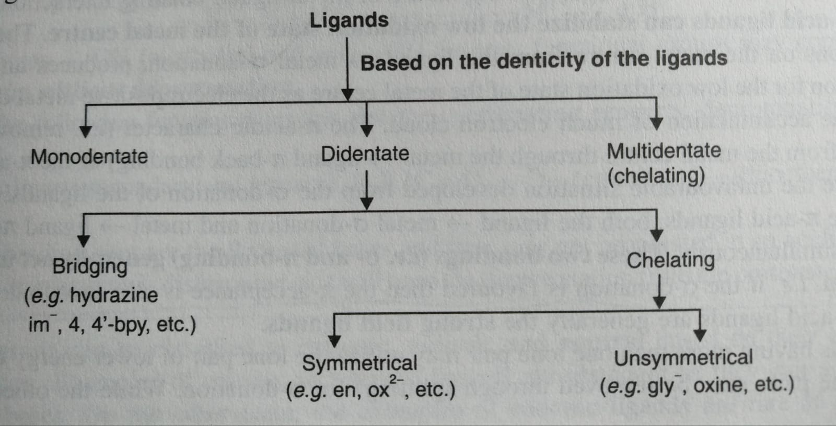
Ligand

Slide 21
Ligand
On the basis of number of coordinating sites
Monodentate = 1 (NH₃, H₂O)
Bidentate = 2 (bpy, phen)
Tridentate = 3 (di ethylene tri-amine)
Tetradentate = 4 (tri-ethylene tetra-amine)
Penta dentate =5 (ethylenediamine triacetic acid anion),
Hexadentate = 6 (EDTA)
polydentate = 2 or more donor atoms
polydentate = Chelating ligand

Slide 22
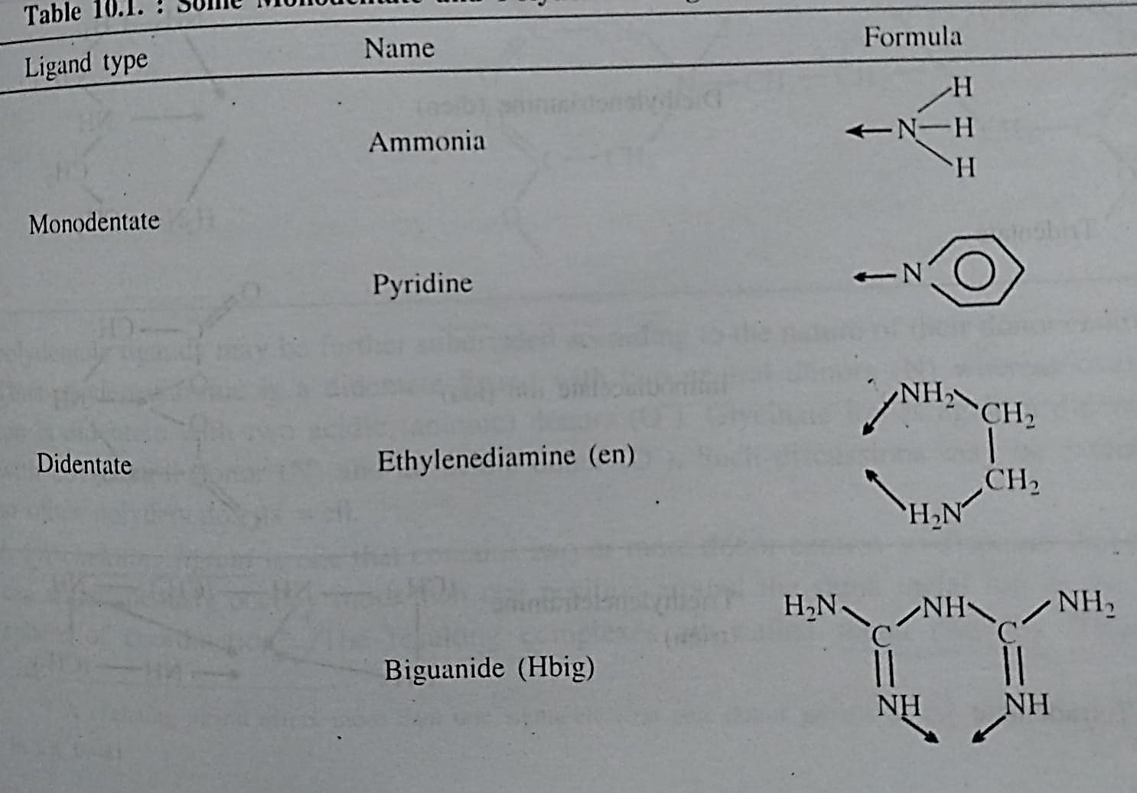
Ligand

Slide 23
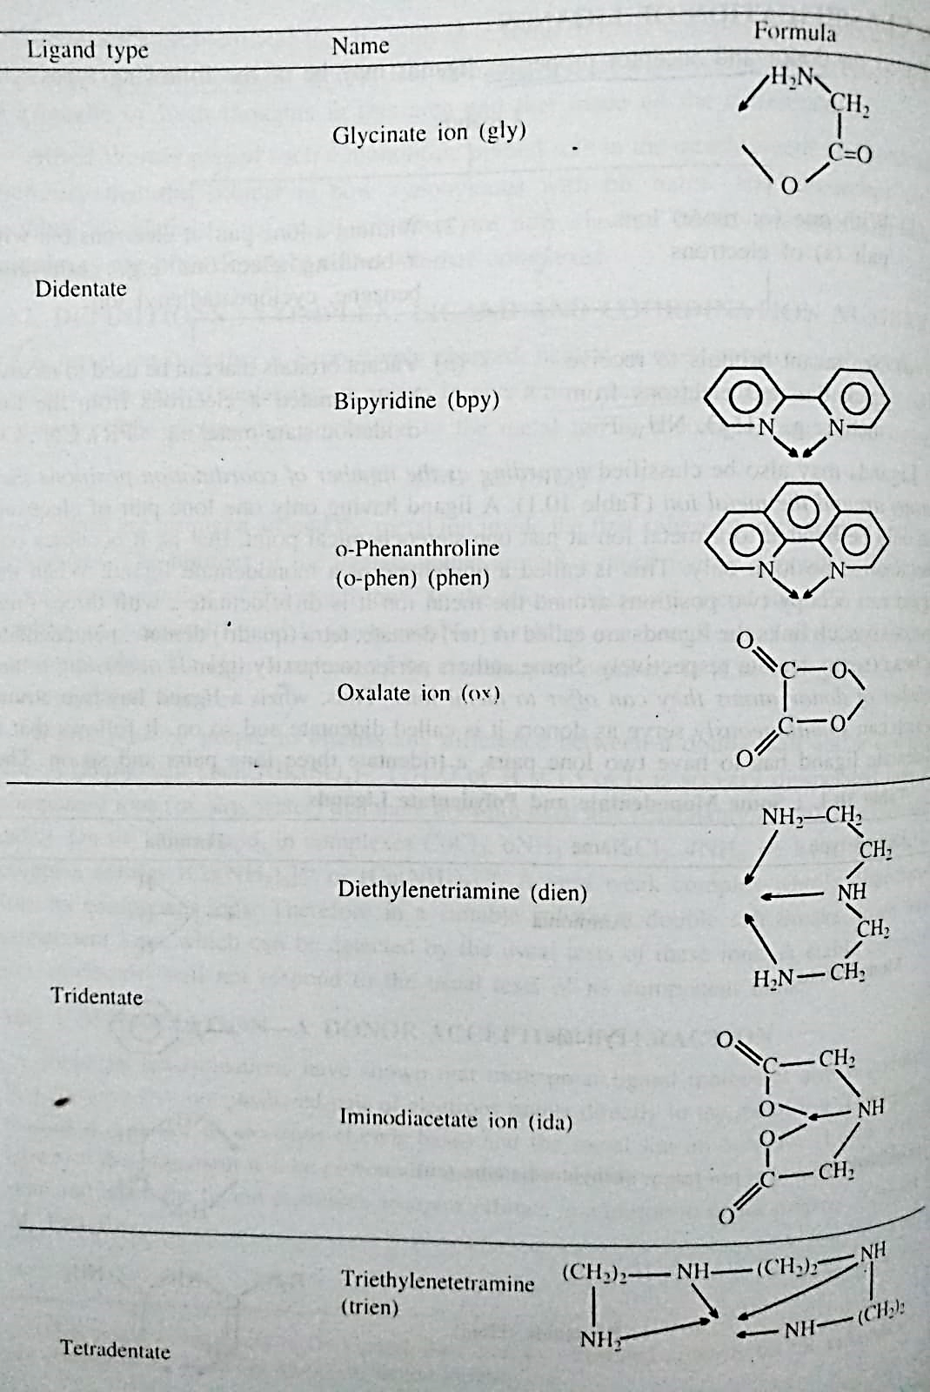
Ligand

Slide 24
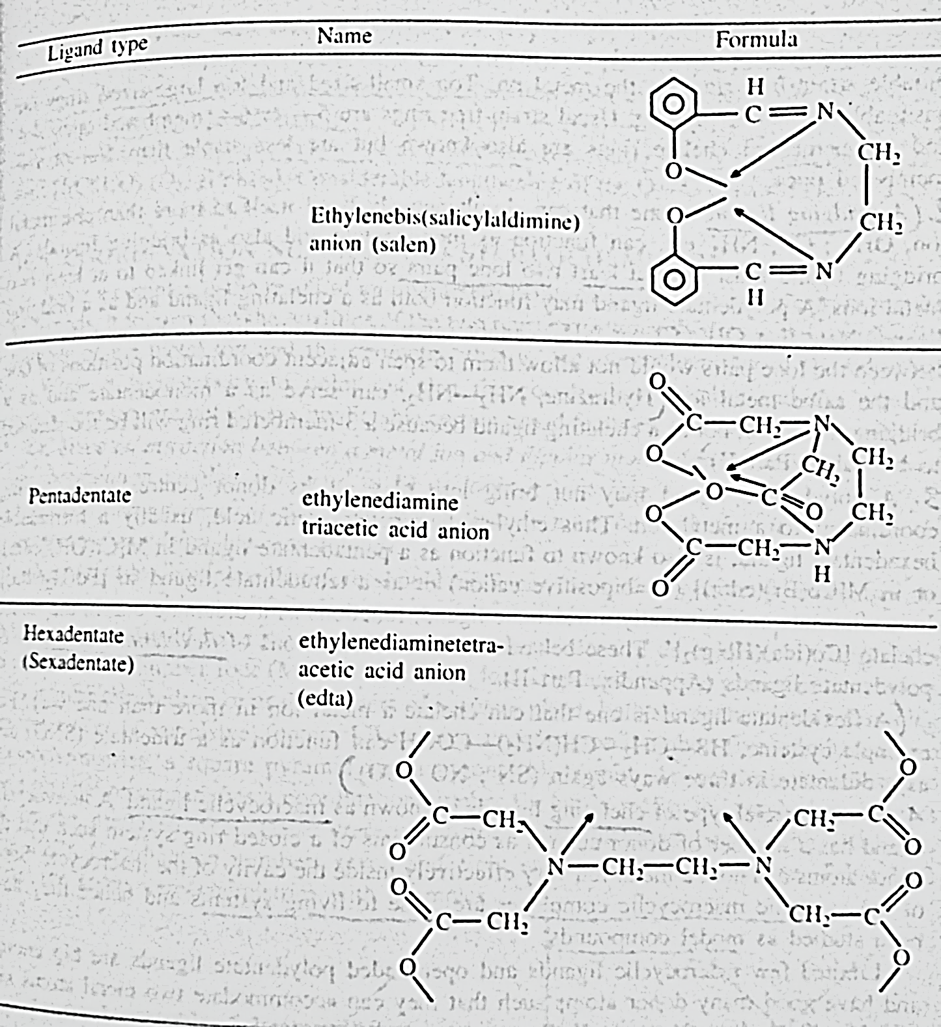
Ligand

Slide 25
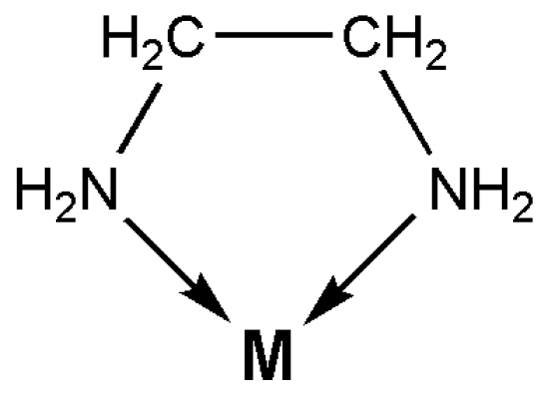
Ligand
Chelating: A chelating ligand is one that contains two or more donor centers convergent towards the same metal ions. The resulting complexes are called metal chelate.
Stable 5 & 6 membered chelate ring
4 & 7 membered rings are known but less stable
3 membered chelate ring is rare

Slide 26
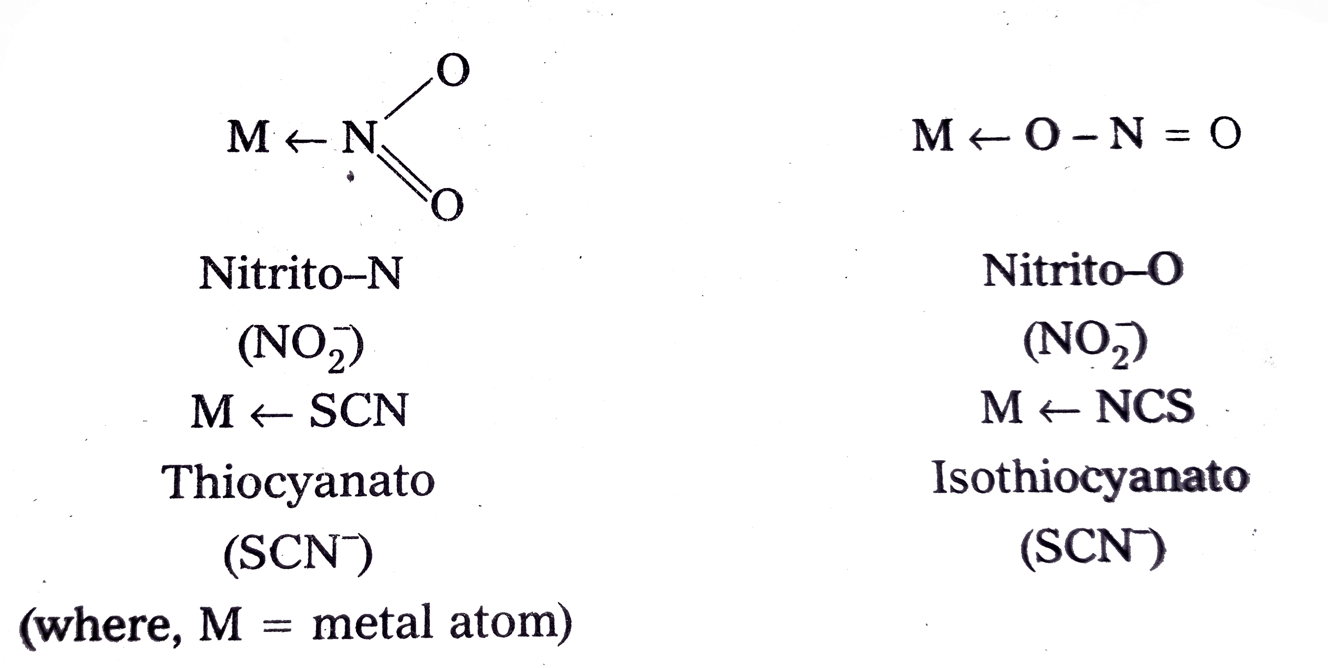
Ligand
(b) Ambidentate: If a ligand has 2 or more donor atoms, but it forms complex by Mono dentate ligands with different sites of bonding: SCN⁻, NCS, NO₂

Slide 27
Ligand
(c) Flexidentate: A flexidentate ligand is one that can chelate a metal ion in more than one way. For ex. Cysteine (HS-CH₂-CH(NH₂)-COOH) can function as a tridentate (SNO) and as a didentate in three ways (SN; NO; SO)

Slide 28
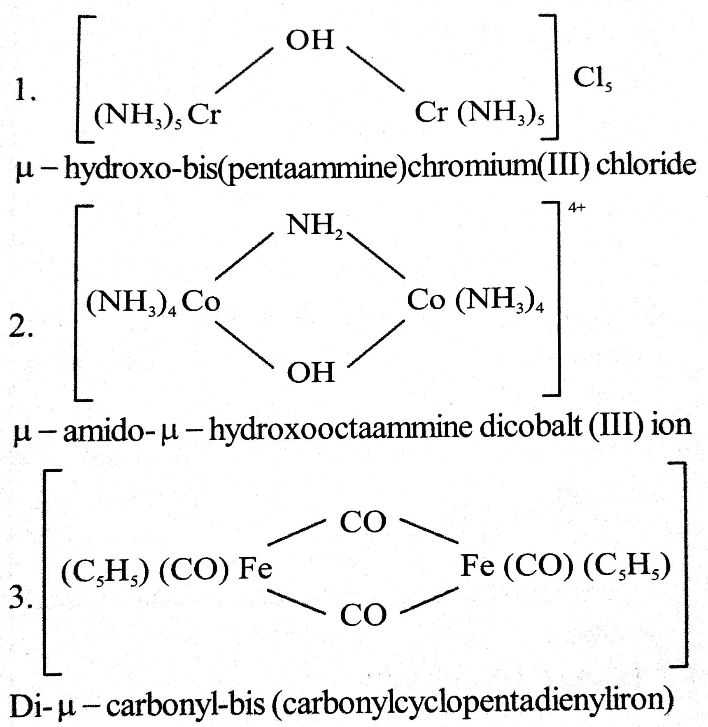
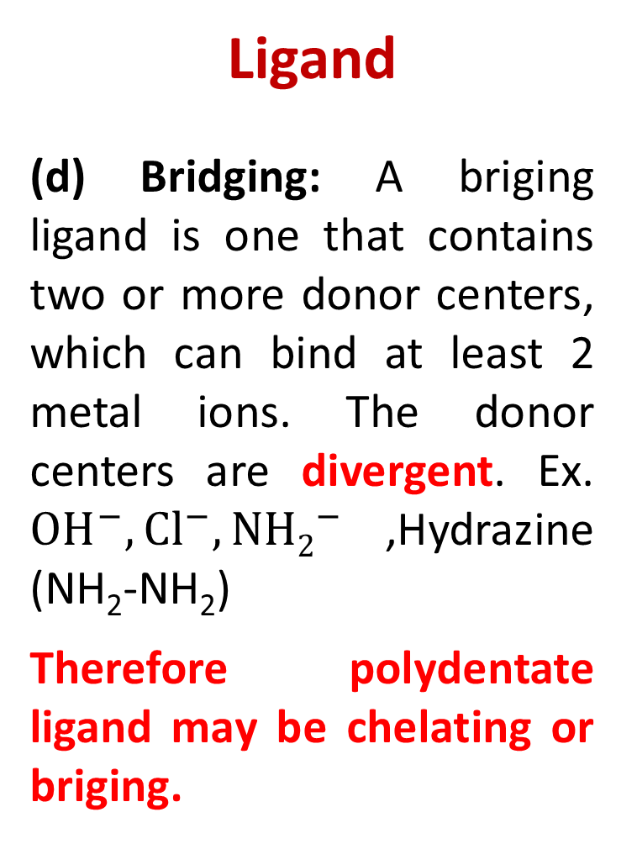
Ligand
(d) Bridging: A briging ligand is one that contains two or more donor centers, which can bind at least 2 metal ions. The donor centers are divergent. Ex. ${OH}^{−},{Cl}^{−},{NH2}^{−}$,Hydrazine (NH₂-NH₂)
Therefore polydentate ligand may be chelating or briging.

Slide 29
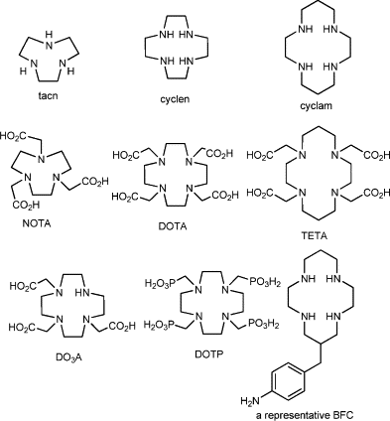
Ligand
(e) Macrocyclic: a macrocyclic ligand has a number of donor centres as constituents of a closed ring system such as the donor atoms can hold a metal ion very effectively inside the cavity of the macrocycle. Ex. Hemoglobin, Chlorophil II etc.

Slide 30
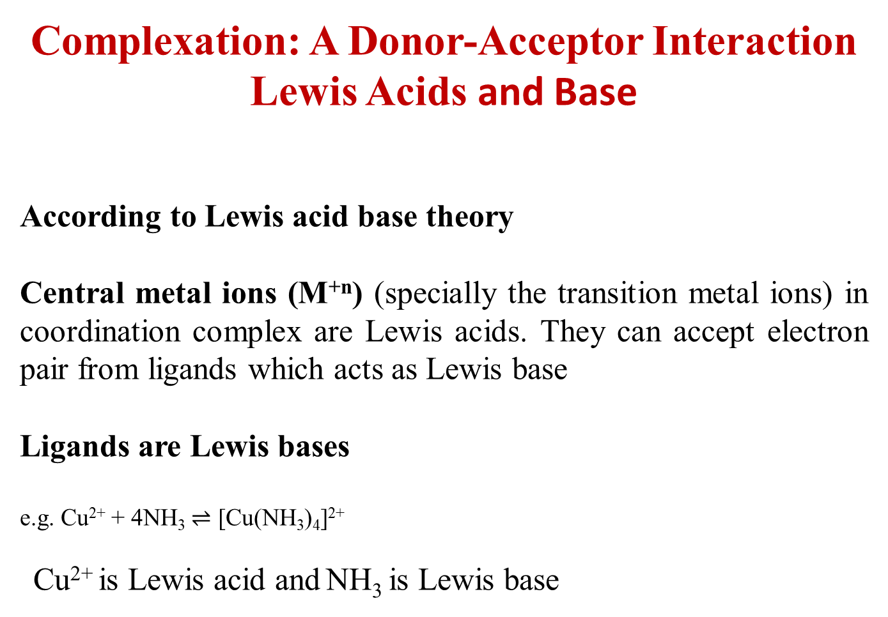
Complexation: A Donor-Acceptor Interaction
Lewis Acids and Base
According to Lewis acid base theory
Central metal ions (M^{+n}) (specially the transition metal ions) in coordination complex are Lewis acids. They can accept electron pair from ligands which acts as Lewis base
Ligands are Lewis bases
e.g. Cu²⁺ + 4NH₃ $⇌$ [Cu(NH₃)₄]²⁺
Cu²⁺ is Lewis acid and NH₃ is Lewis base

Slide 31
Homolyptic & Heterolyptic Complex
Homolyptic: When all the ligands around a metal ion are same in the complex, Ex. [Co(NH₃)₆]³⁺
Heterolyptic: When the ligands around a metal ion are different in the complex, Ex. [CoCl(NH₃)₅]²⁺

Slide 32
Coordination Number & Stereo Chemistry
Since an attraction between a metal ion and dipolar molecules or anions is involved the coordination number will tend to be as large as possible.
2. The arrangement of the coordinated ligands must be such that it minimises the electrostatic repulsion between ligands.

Slide 33
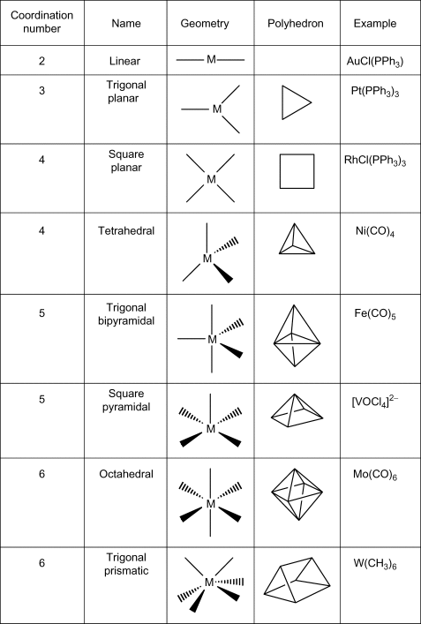
Coordination Number & Sterio Chemistry

Slide 34
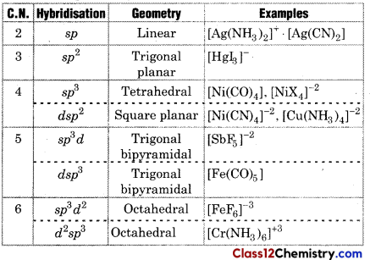
Coordination Number, Geometry & hybridisation

Slide 35
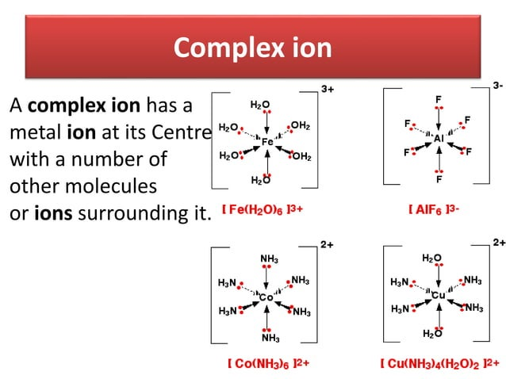

Slide 36
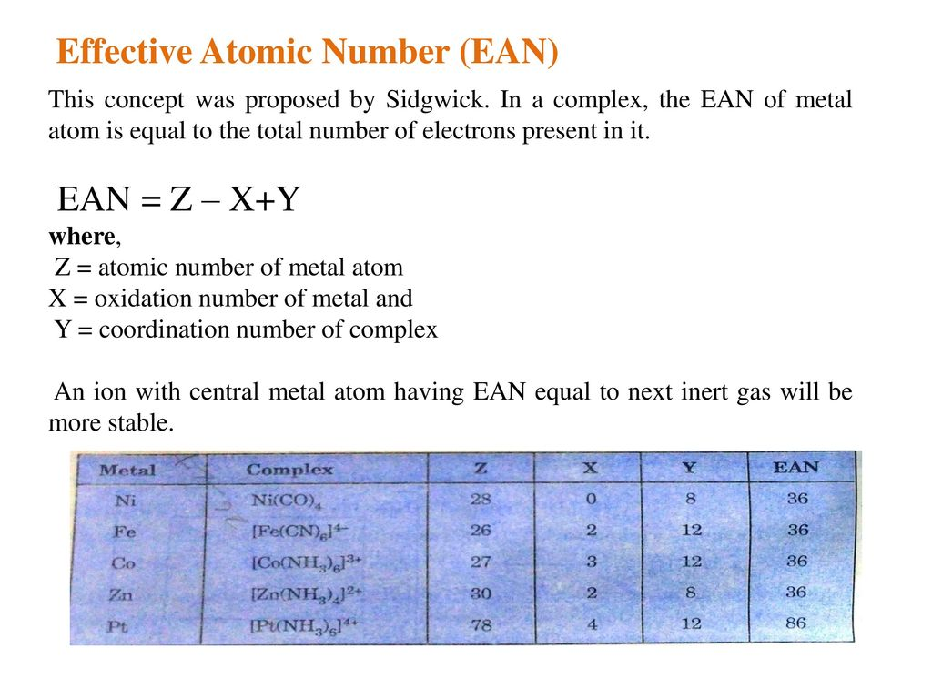

Slide 37
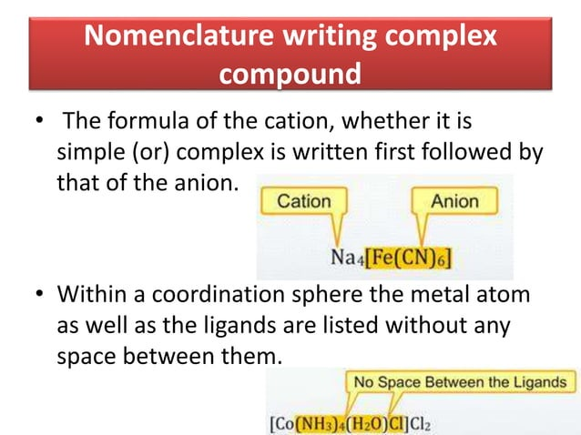

Slide 38
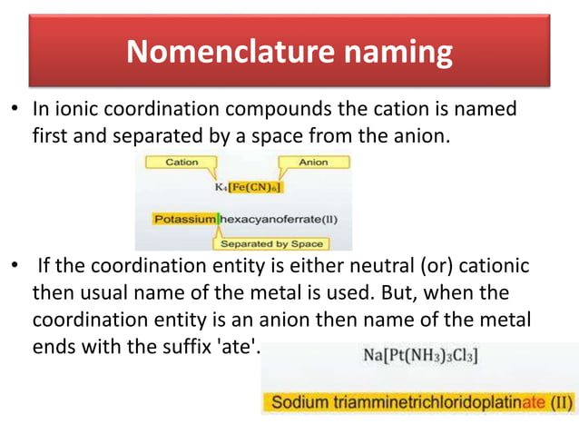

Slide 39
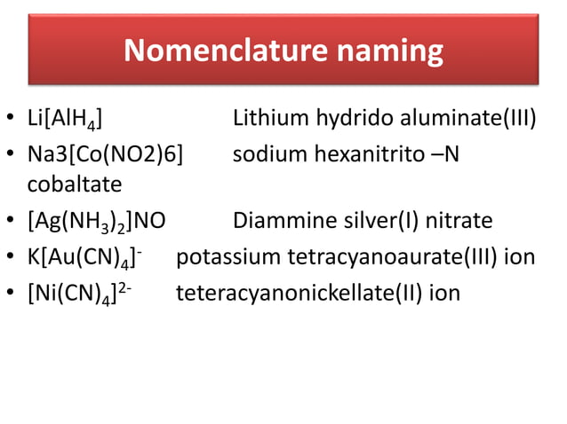

Slide 40
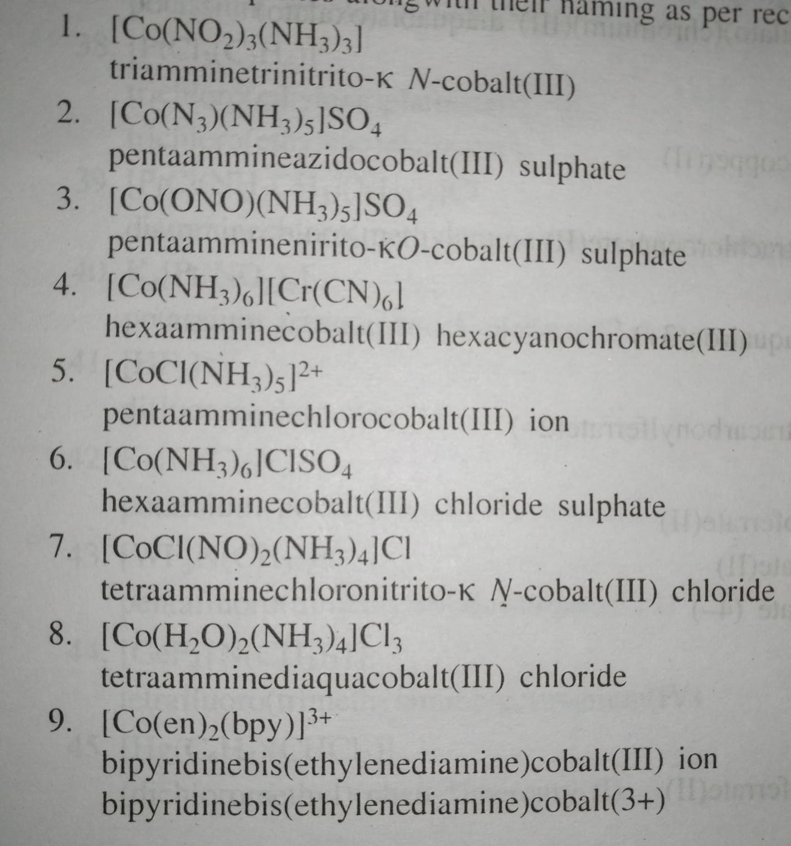

Slide 41
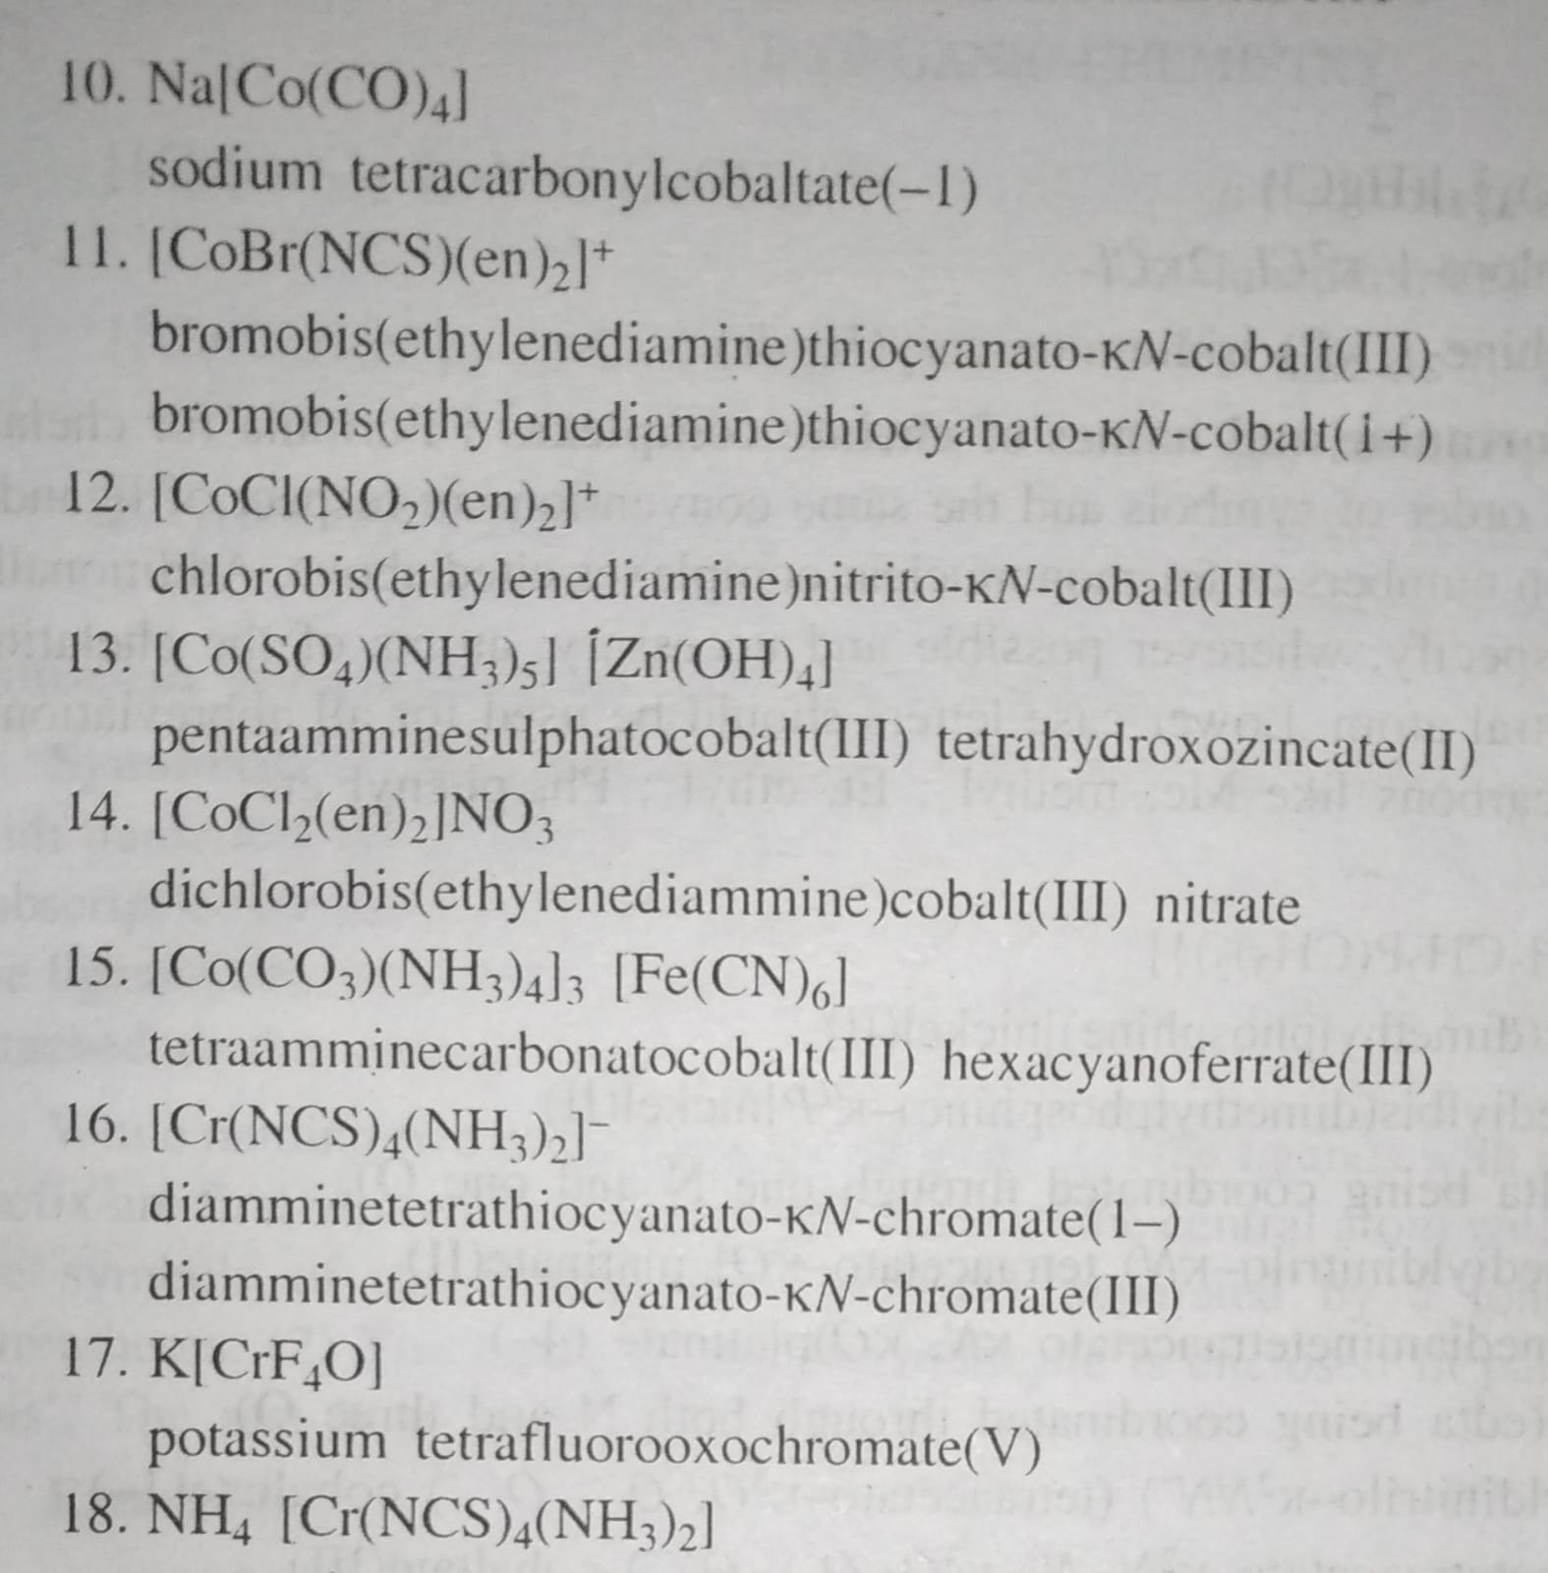

Slide 42
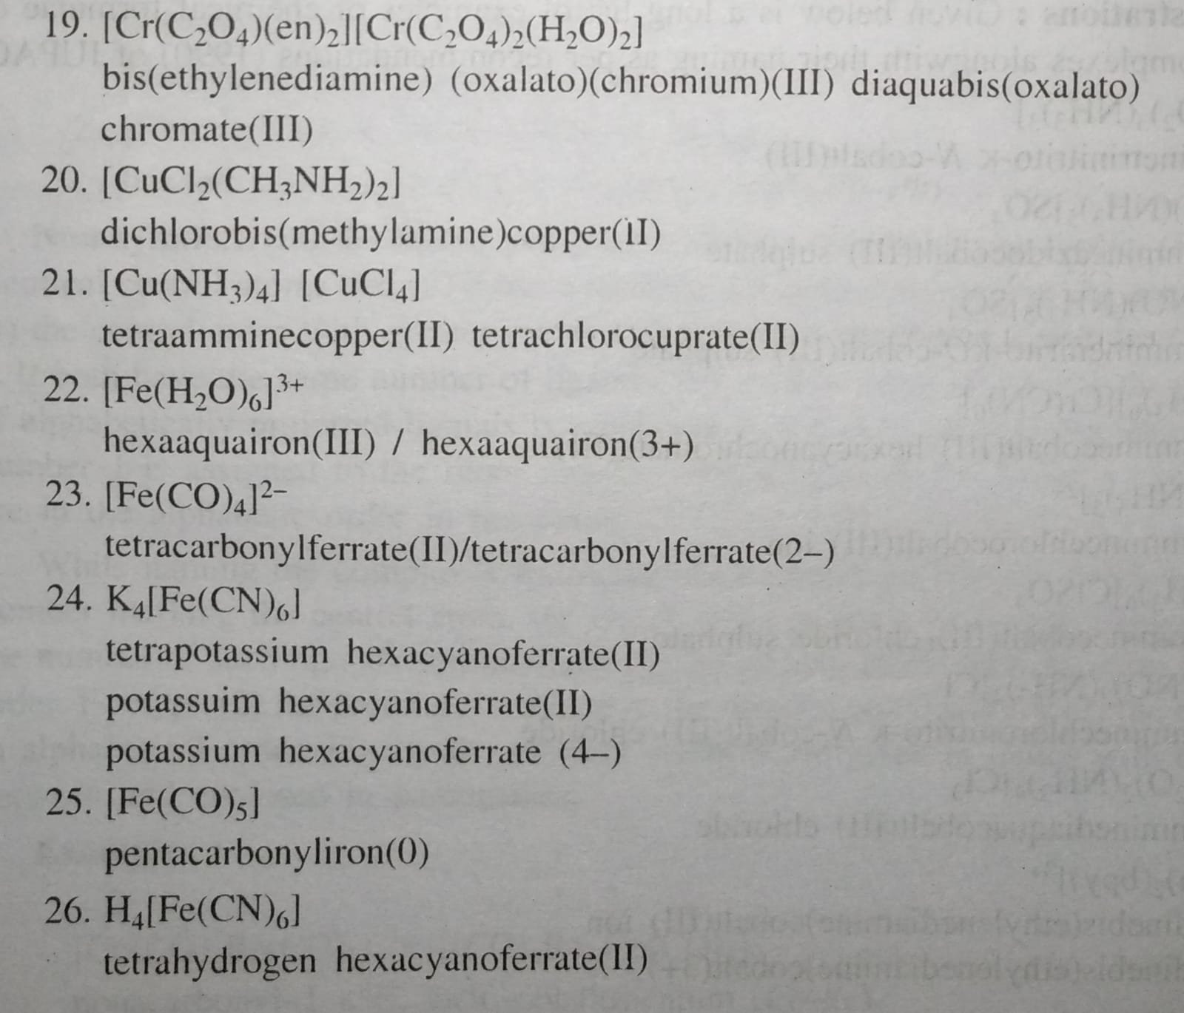

Slide 43
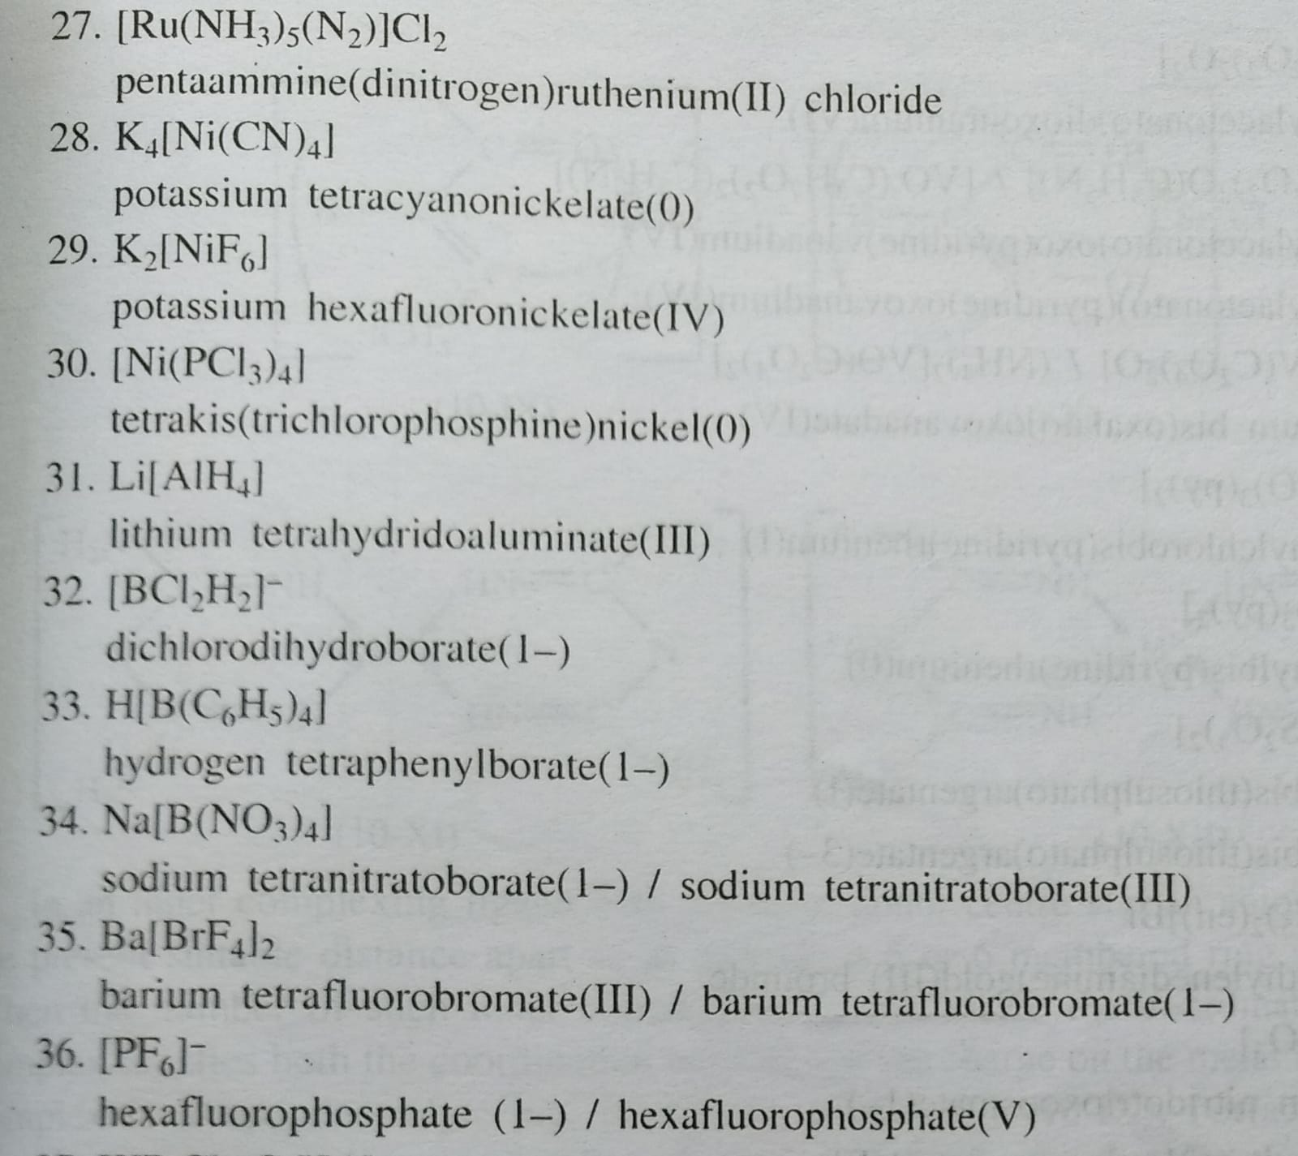

Slide 44
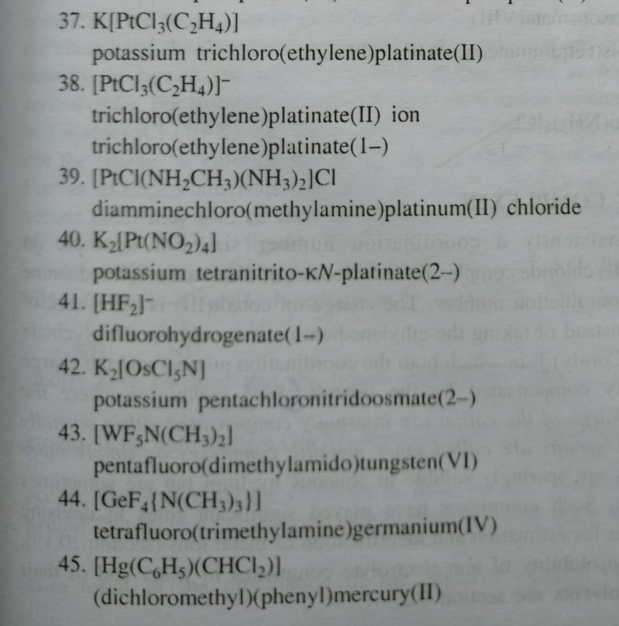

Slide 45
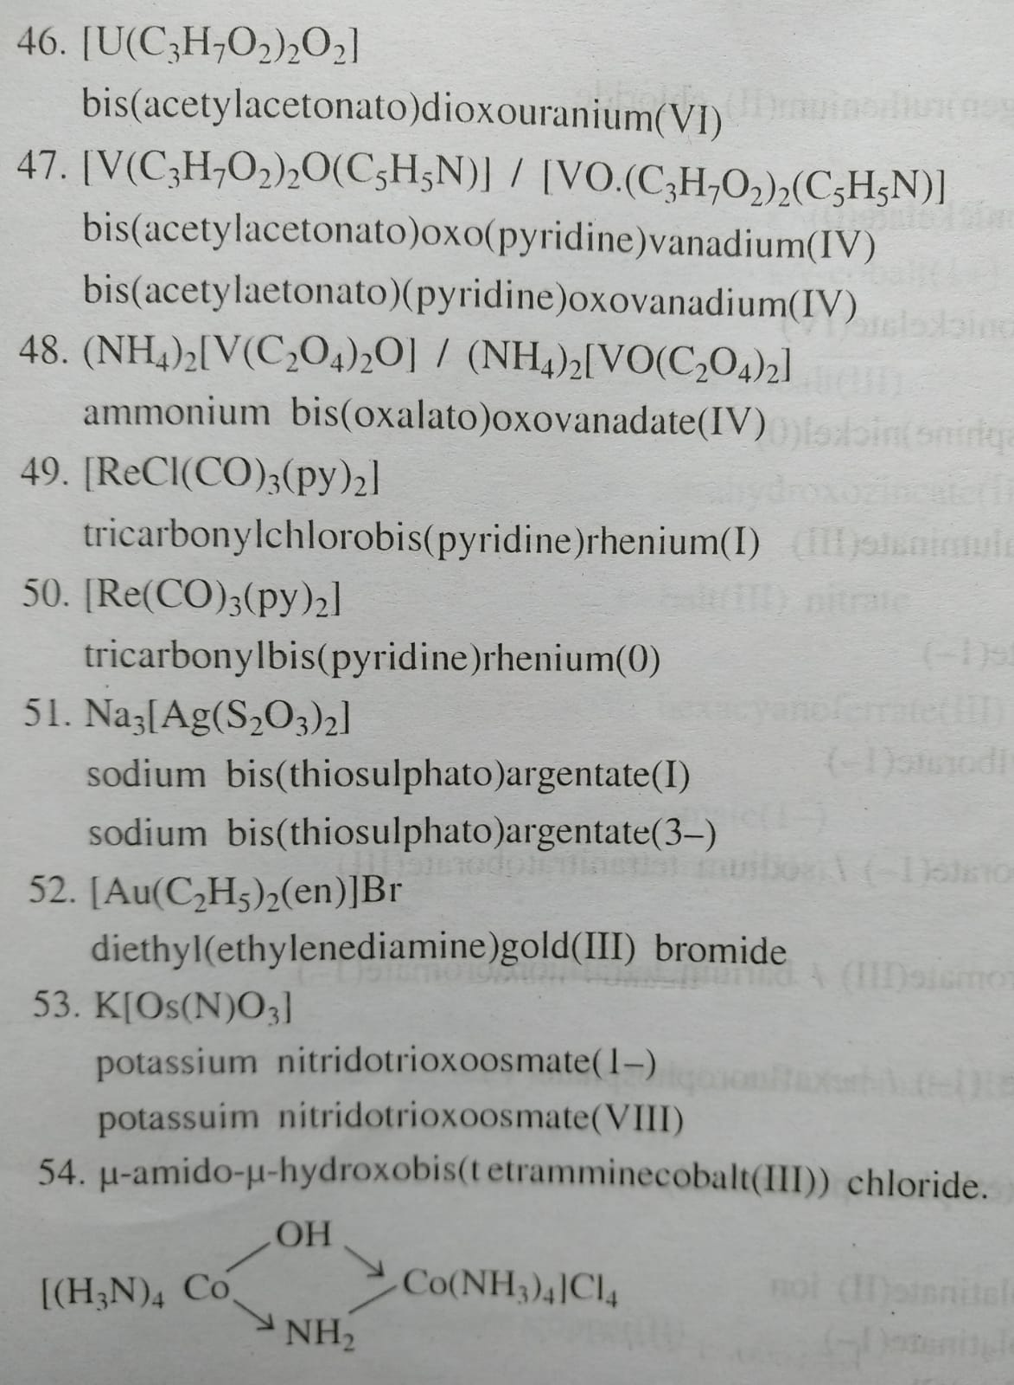

Slide 46
Isomerism in Coordination Compounds
Compounds which have the same chemical composition and different properties this phenomenon is called isomerism.
Same Chemical formula → Different Properties

Slide 47
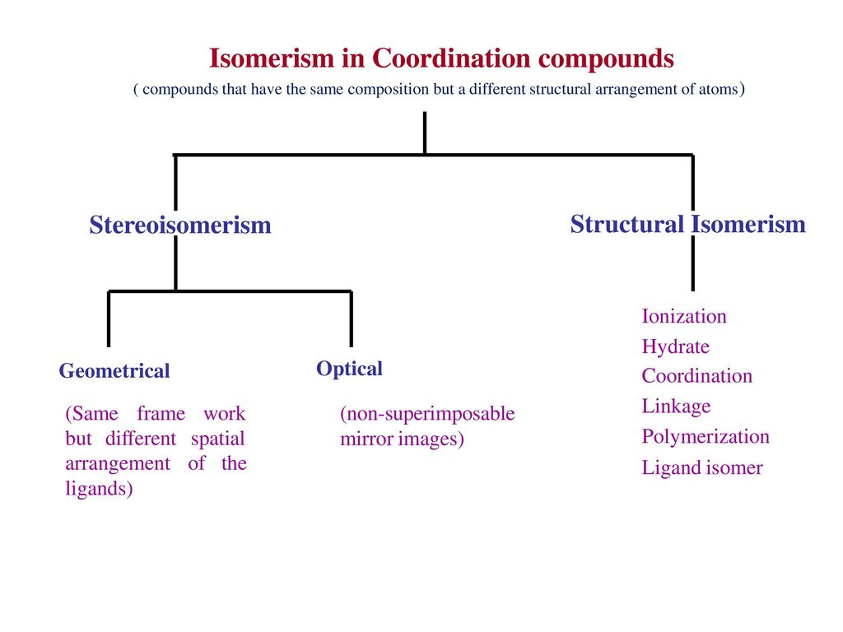

Slide 48
Structural Isomerism
Compounds which have the same chemical composition and different structural arrangements are called structural isomerism.
Ionisation Isomerism (Forming different ions)
Hydrate Isomerism (must have water of crystallisation)
Ligand Isomerism
Linkage Isomerism (Ambidentate ligands)
Coordination Isomerism (Both complex ions)
Coordination Position Isomerism (Polynuclear complexes)

Slide 49
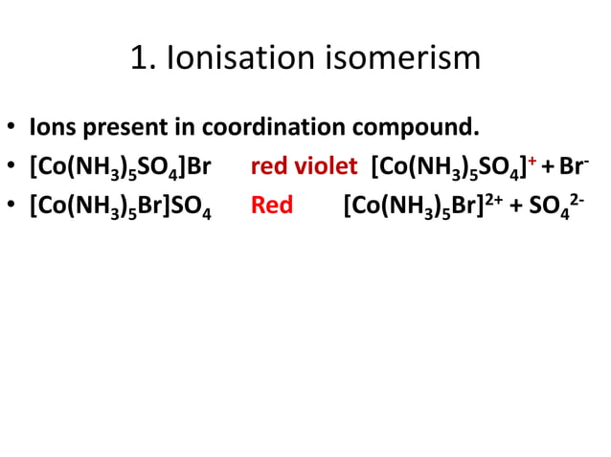

Slide 50
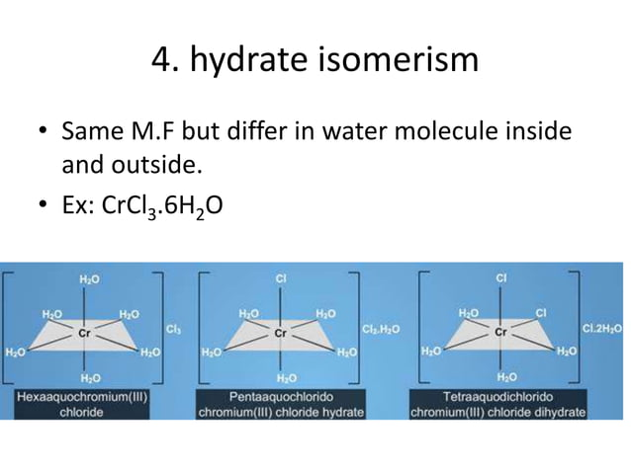

Slide 51
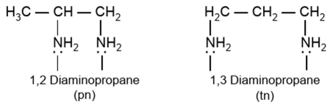
Ligand Isomerism
Some ligands themselves are capable of existing as isomers e.g. diamino propane can exist both as 1, 2-diamino propane (pn) and 1, 3-diamino propane (tn)

Slide 52
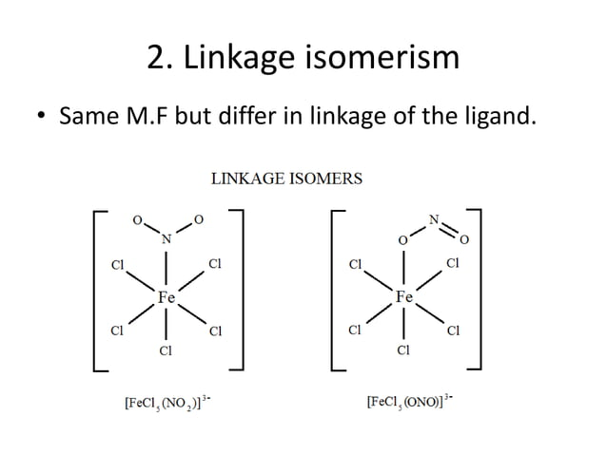

Slide 53
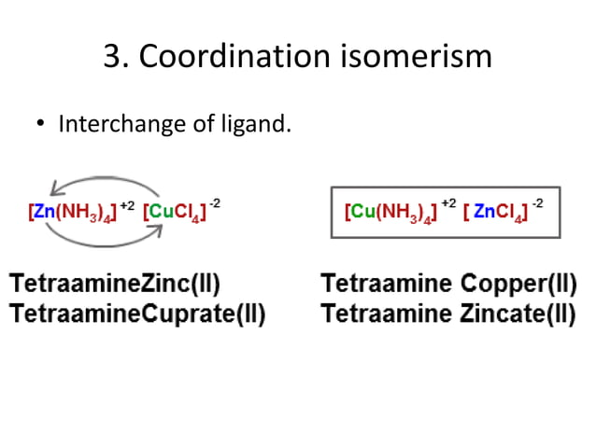

Slide 54
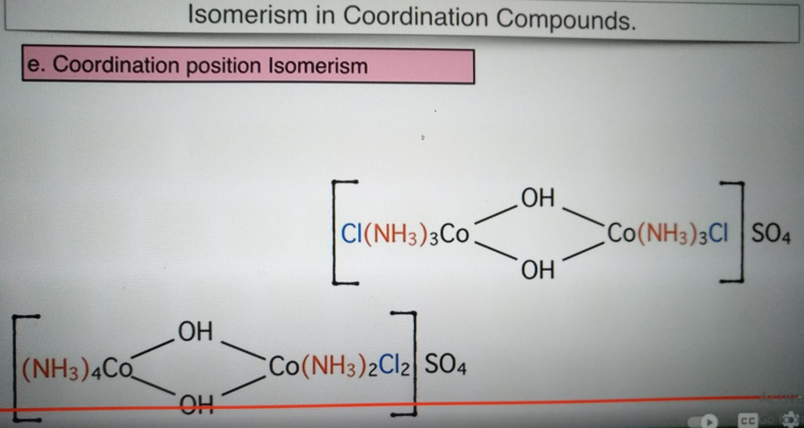

Slide 55
Stereoisomerism
When 2 compounds contain the same ligands coordinated to the same central ion, but the arrangement of ligands in space is different, the two compounds are said to be stereoisomers and the type of isomerism is called stereoisomerism.
Stereoisomerism is of 2 types:
Geometrical isomerism
Optical or mirror-image isomerism

Slide 56
Geometrical Isomerism
Geometrical isomers have identical empirical formula but differ in chemical and physical properties because of the different arrangement of ligands. They are usually easily separated by chemical or physical means. Some (not all) of the isomers may develop optical activity due to distinct mirror-image forms. Thus geometrical isomer which is capable of existing in non-superimposable mirror-image forms used to isolate isomers.

Slide 57
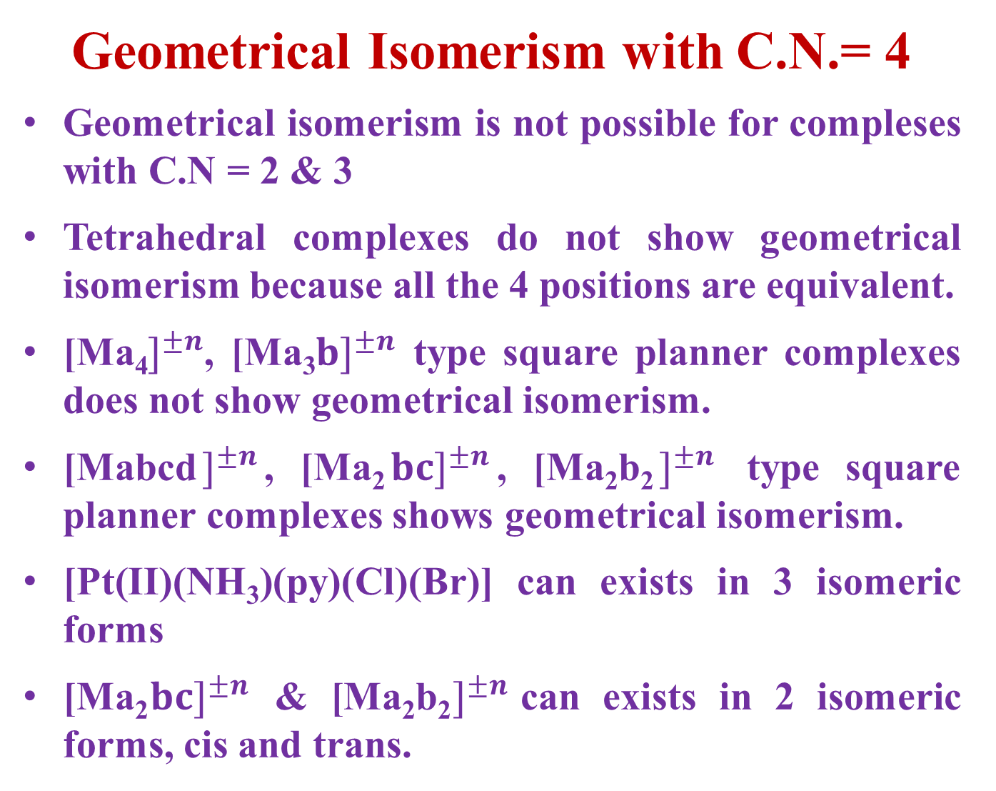
Geometrical Isomerism with C.N.= 4
Geometrical isomerism is not possible for compleses with C.N = 2 & 3
Tetrahedral complexes do not show geometrical isomerism because all the 4 positions are equivalent.
[Ma₄$]^{±n}$, [Ma₃$b]^{±n}$ type square planner complexes does not show geometrical isomerism.
[Mabcd$]^{±n}$, [Ma₂$b{c]}^{±n}$, [Ma₂b₂$]^{±n}$ type square planner complexes shows geometrical isomerism.
[Pt(II)(NH₃)(py)(Cl)(Br)] can exists in 3 isomeric forms
[Ma₂$b{c]}^{±n}$ & [Ma₂b₂$]^{±n}$can exists in 2 isomeric forms, cis and trans.

Slide 58
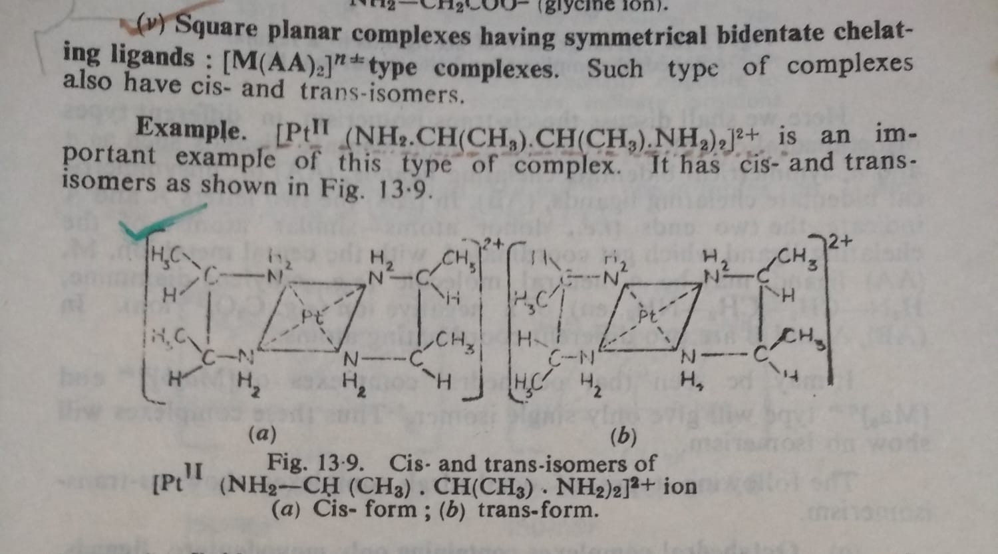
Geometrical Isomerism with C.N.= 4

Slide 59
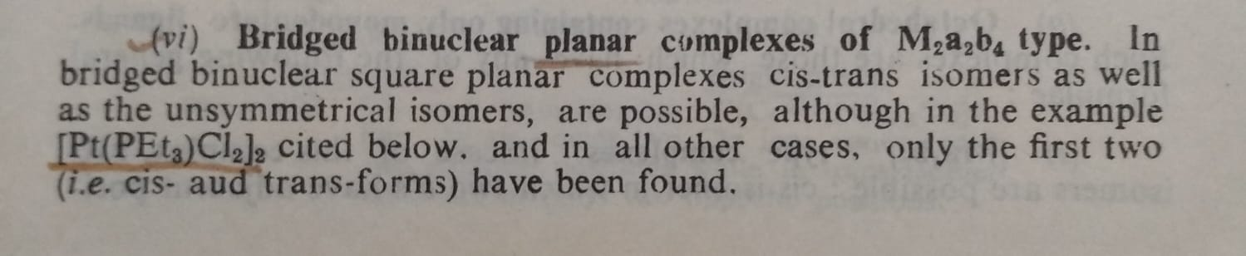
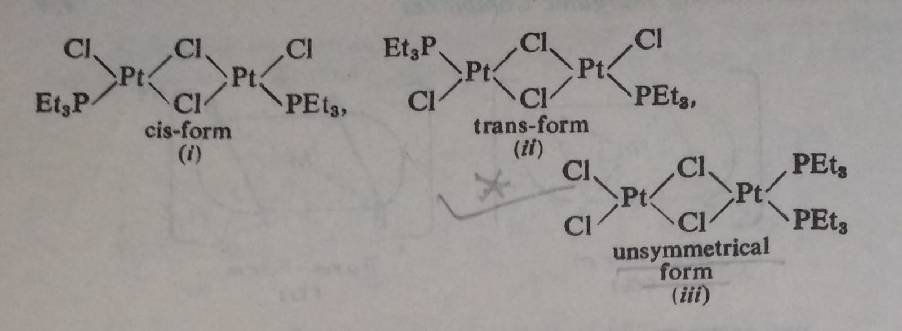
Geometrical Isomerism with C.N.= 4

Slide 60
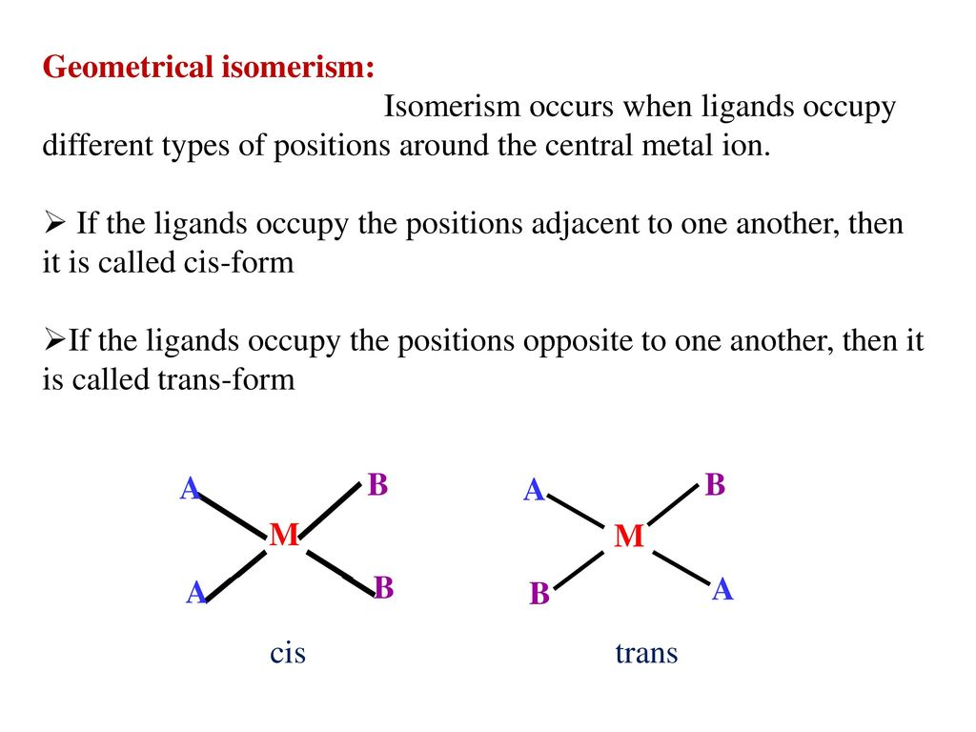

Slide 61
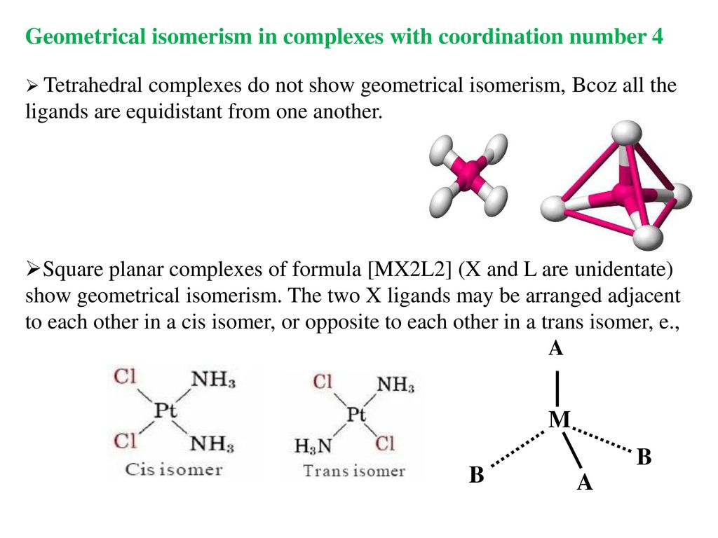

Slide 62
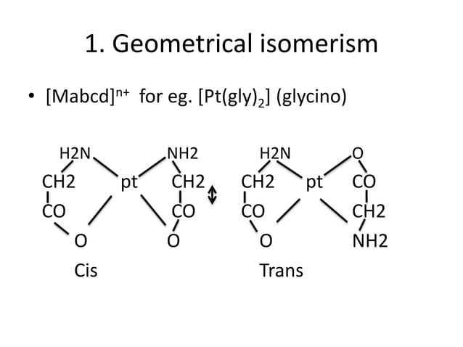

Slide 63


Slide 64


Slide 65


Slide 66
How can we understand the cis or trans isomer?
The following methods may be used to distinguish between cis-and trans-isomers.
Dipole Moments Measurements.
Jensen has shown that the Pt(ll) complexes of [Pt(II) A₂X₂] type where A = substituted phosphine, arsine or stilbine such as (C₂H₅)₃P, (C₃H₇)₃As or (C₂H₅)₃Sb and X=a halogen, have their dipole moments (μ) either equal to zero or between 8 and 12. Debye units. In the compounds with μ = 0, the individual moments have cancelled one another and so these are trans-isomers. The compound with μ = 8-12 Debye units are cis-isomers.
(2) X-ray Crystal Analysis
X-ray crystal analysis and dipole moment measurements of several Pt(II) complexes have confirmed the square-planarity of the bonds around the central metal atom. This square planar arrangement has also been established for 4-coordinated pt(II), Ag(II) Cu(II) and Au(lll) Tetrahedral configurations have been assigned to Cu(I), Ag(I), Au(I), B(III), Al(III), Zn(II), Cd(ll), Hg(ll) and Co(ll) in their coordination compounds. Some metals such as Ni(ll) appear to show either configuration for 4-coordination.
(3) IR Spectroscopic Technique

Slide 67


Slide 68
OPTICAL OR MIRROR-IMAGE ISOMERISM

Slide 69
OPTICAL ISOMERISM

Slide 71
OPTICAL ISOMERISM

Slide 72

Optical Activity
Optical activity is measured using an instrument called Polarimeter.
A polarimeter allows polarized light to travel through a sample tube containing an sample and the degree of rotation of plane polarized light is measured.

Slide 73
OPTICAL ISOMERISM
When the solutions of certain complex compounds are placed in the path of a plane-polarised light (the waves of the plane- polarised light vibrate only in one direction; vibrations in other directions are cut off), they rotate its plane through a certain angle which may be either to the left or to the right. This property of a complex of rotating the plane of polarised light is called its optical activity and the complex possessing this property is said to be optically active.
Optically active complexes are said to exist in the following forms:
One which rotates the plane of polarised light towards right (i.e. in clockwise direction) is said to be dextro-rotatory or d-form. d-form is also represented by placing (+) sign before its name or formula.
One which rotates the plane of polarised light towards left (i.e. in anti-clockwise direction) is called laevo-rotatory or l-form. l-form is also represented by putting (-) sign before its name or formula.
(+), dextro, and (-), laevo, refer to the sign of rotation of the optical isomer at the sodium D line wavelength.

Slide 74
OPTICAL ISOMERISM
The d- and l-forms have the following characteristics :
Since d- and l-forms are capable of rotating the plane of polarised light, these are said to be optically active forms or optical isomers and this phenomena is called optical activity or optical isomerism.
These two forms have exactly identical physical and chemical properties, although they differ in their action on polarised light.
d- and l-forms are mirror images to each other just as left hand is the mirror image of the right hand. Thus d- and l-forms can not be superimposed on each other. Since these forms are related to each other as mirror-images, they are commonly called enantiomorphs (Latin: enantio opposite, morphs = forms) or enantiomers.
Thus optical isomerism is now often referred to as enantiomerism.
(c) One which is not capable of rotating the plane of polarised light is called optically inactive. Such an isomer is called racemic-, dl-or (±)form. A recemic substance is composed of 50% d- and 50% 1-form. The solution of a recemic (dl-mixture) form in a solvent which contains equimolecular recenic and forms is inactive, because the rotation (of the plane of polarised light) produced by one isomer, say d-isomer, is balanced or compensated by equal but opposite rotation produced by the other l-isomer). inactivity produced in dl-mixture is said to be due to external compensation.

Slide 75
OPTICAL ISOMERISM
Conditions for a molecule to show optical isomerism.
A molecule in which the grouping of the atoms in the molecule in asymmetric is called an asymmetric or dissymmetric molecule.
An asymmetric molecule has the following features:
An asymmetric molecule never has a plane of symmetry (also called mirror-image plane) which is defined as an imaginary plane which divides the molecule in such a way that the part of it on one side of the plane is the mirror image of that on the other side of the plane. The molecules possessing such a plane of symmetry are always inactive while those having no plane of symmetry are optically active and hence show optical isomerism.
An asymmetric molecule cannot be superimposed on its mirror image.
Thus the most necessary and sufficient condition for a molecule to show optical isomerism (i.e. to exist in d- and d l-forms) is that
the molecule should be asymmetric, i.e. it should have no plane of sym- metry, and
the molecule should not be superimposable on its mirror image.

Slide 76


Slide 77
OPTICAL ISOMERISM
OPTICAL ISOMERISM IN 4-AND 6-COORDINATION COMPOUNDS
No optical isomerism is possible with tetrahedral and square planar complexes of the type: [Ma₄], [Ma₃b] and [Mab₃] because all the possible arrangements of the ligands round the central metal ion, M are exactly equivalent.
Square planar Complexes
Optical isomerism rarely occurs in square planar complexes, since they have all the four liga ligands and the central metal ion in the same plane and hence contain a plane or axis of symmetry. Thus these complexes are optically inactive, they cannot show optical isomerism even if all the four ligands are different. Although, as mentioned above, square planar complexes seldom show optical isomerism, yet a four-coordinated complex of of Pt (II) viz. iso-butylenediamine-meso stilbenediamine platinum (II) cation, [P(ll) (NH₂ CH (C₆H₅) CH (C₆H₅). NH2) (NH₂.CH₂.C(CH₃)₂.NH₂)]²⁺ which has square-planar shape has resolved into two forms by Mills and Quibell is 1935.

Slide 78

Proof of square planner geometry
square planner complex is optically active

Slide 79

Proof of square planner geometry
Tetrahedral complex is optically inactive
Actually molecule is o. active, therefore square planner

Slide 80

(B) Tetrahedral Complexes
(i) A tetrahedral complex of [Mabcd] type occurs in two optical isomers. Here it may be noted that 4 different groups round the central metal ion are not the only requirement to make the complex to show mirror-image isomerism. All that is required is that the molecule should be asymmetric (i.e., unsymmetrical), i.e. it should have no plane of symmetry so that it can exist in two mirror-image forms

Slide 81

(B) Tetrahedral Complexes
(ii) Tetrahedral complexes of Be(II), B(III) and Zn(II) with unsymmetrical bidentate ligands have been made and they are optically active. An example is bis(benzoylacetonato) beryllium (II) complex, which has 2 optical isomers. Here it may be noted from the Fig. that the complex has no centre or plane of symmetry and the two forms are not superimpos- able on each other. This explains the resolution of the complex into d- and l-forms.

Slide 82
Geometrical & Optical isomers for Coordination Number 4
Complex | Square planar geometry | Tetrahedral geometry
[MA₄] | No isomerism | No isomerism
[MA₃B] | No isomerism | No isomerism
[MA₂B₂] | Cis and trans isomers | No isomerism
[MA₃BC] | Cis and trans isomers | No isomerism
[MABCD] | 3 geometrical isomers but no optical isomerism | 2 optical isomers but no geometrical isomerism

Slide 83


(C) Octahedral Complexes.
Optical isomerism is very common in the following types of octahedral complexes:
Octahedral complexes containing only monodentate ligands.
The following of octahedral complexes have optical isomers:[Ma2b2c2], [Ma2b2cd], [Ma₂bcde] and [Mabcdef].
(i) [Ma2b2c2] type complex: It has two optical isomers as shown below in Fig.
(ii) [Mabcdef] type complex: Complexes of this type having six different monodentate ligands have been prepared only for Pt(IV). Only a few isomers have been isolated, but there could be 15 geometrical isomers, each of which could exist in d- and l-forms to give a total of 30 optical isomers.

Slide 84

(b) Octahedral complexes containing only symmetrical bidentate chelating ligands.
Such complexes may be of the following types:
(i) [M(AA)₃]^{n} type complexes: Here (AA) is a symmetrical bidentate chelating ligand which may be a neutral molecule or a negative ion. The optical isomers of this type of complexes are shown below in Fig.
Examples: [Co(lll) (en)3]3+, [Co(lll) (pn)3]3+, [Pt(IV) (en)3]4+, [PIV (pn)], [Cdll (pn)]*+, [Fell (diph)]+ [Fell (diph)]+, [RLIV (en),], [IrIV (pn),]+, [ZnI (en),]+, [MIII (C₂O) where MIII Alt+, Co³+, Fe3+, Rh+, Cr+-and Ir

Slide 85

(ii) [M(AA)₂(BB)] ^{n±} type complexes.
Here (AA) and (BB) are two different symmetrical bidentate chelating ligands. Note that (AA) is a neutral ligand while (BB) is an anionic ligand. The two enantiomers (or enantiomorphs) of [M(AA)2(BB)] ^{n±} type complexes are shown below in Fig.
Examples: The ions namely [Co(lll)(en)₂(CO₃)]⁺ and [Co(lll)(en)₂(C₂O₄)]⁺ belong to this class of complexes.

Slide 86

(c) Octahedral complexes containing monodentate and symmetrical bidentate chelating ligands.
Such complexes may be of the following types:
(i) [M(AA)₂a₂]^{n±} type complexes.
Here (AA) is a chelating ligand and a is a unidentate (i.e. mono-dentate) ligand.

Slide 87


Slide 88


Slide 89

(d) Octahedral complexes containing optically active ligands.
[Co(III)(en)(pn)(NO₂)₂]⁺ ion is an important example of such type of octahedral complexes. Here pn is optically active ligand. We have already seen that this complex exists in two cis and two trans isomers (see Fig.). Each of the two cis- forms namely (a) and (b) shown below gives its corresponding optical isomer (e) and (f) respectively as shown below in Fig. 13.41.
Trans isomers (c) & (d) are symmetrical and hence are optically inactive, i.e. they do not give any optical isomers

Slide 90


Slide 91


Slide 92


Slide 93


Slide 94


Slide 95


Slide 96


Slide 97


Slide 98
Reference
W.U. Malik, G.D. Tuli & R.D. Madan, Selected Topics in Inorganic Chemistry, S. Chand & Company Ltd.
Ashim K Das & Mahua Das, Fundamental Concept of Inorganic Chemistry, CBC Publishers & Distributors, Volume 4, First Edition, 2014
R.L. Dutta & G.S. De, Inorganic Chemistry, Part-1, The New Book Stall, 6th Edition 2009

Slide 99
Thank you

